Slide 1
Speak Your Mind: Introducing Aptly, The Software Platform that turns Ideas into Working Apps
David Y.J. Kim, Ashley Granquist, Evan Patton, Mark Friedman, Hal Abelson
Notes:
Hi this is David Kim from the MIT App Inventor team. It is a pleasure to share our work to everyone.

Slide 2
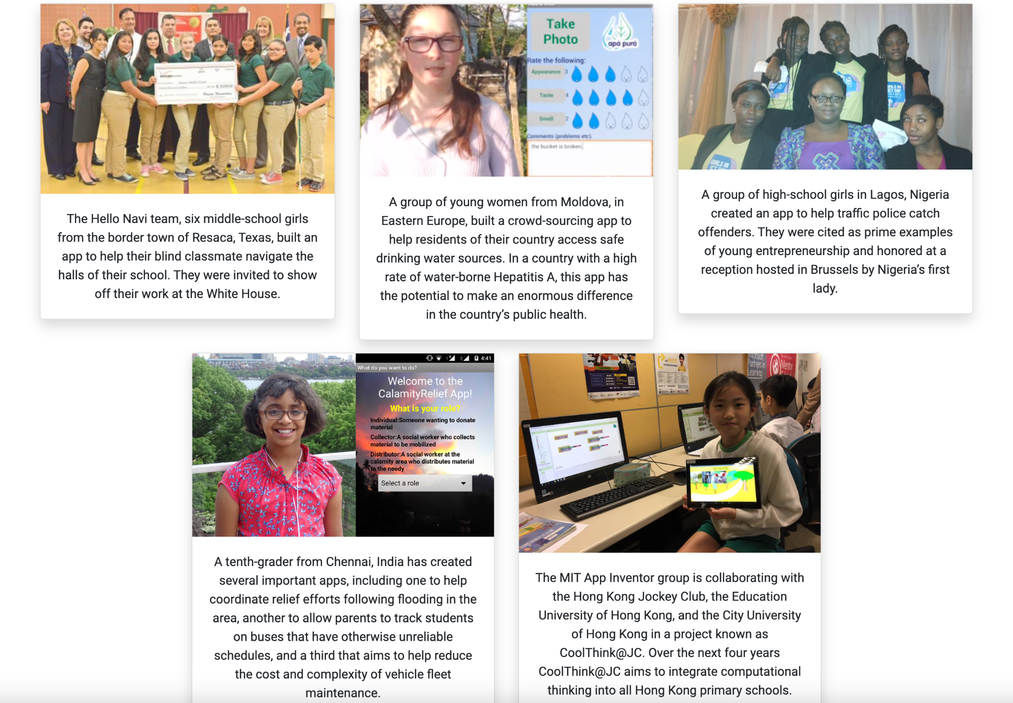
Introducing the Team and the Goal
Notes:
MIT app inventor invites everyone, especially kids, to build mobile applications that can change their lives and help their community.
Here on the right we have some examples of kids using the App Inventor platform enhancing their community. My favorite example is this middle-school girls building an app to help their blind classmate navigate the halls of their school.

Slide 3
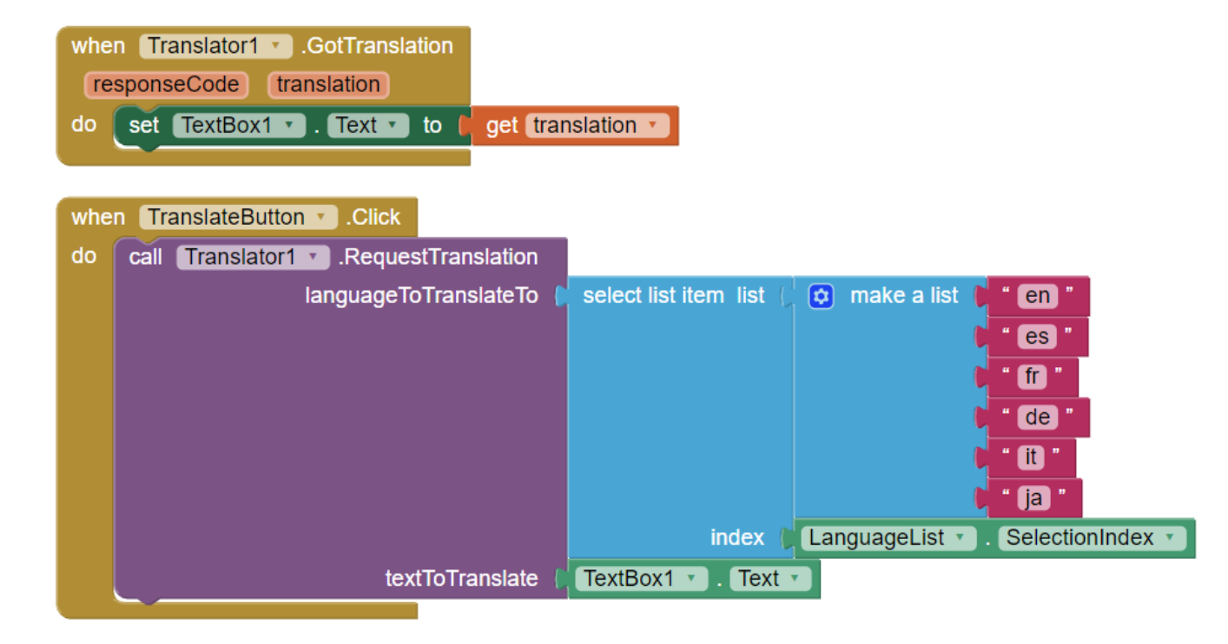
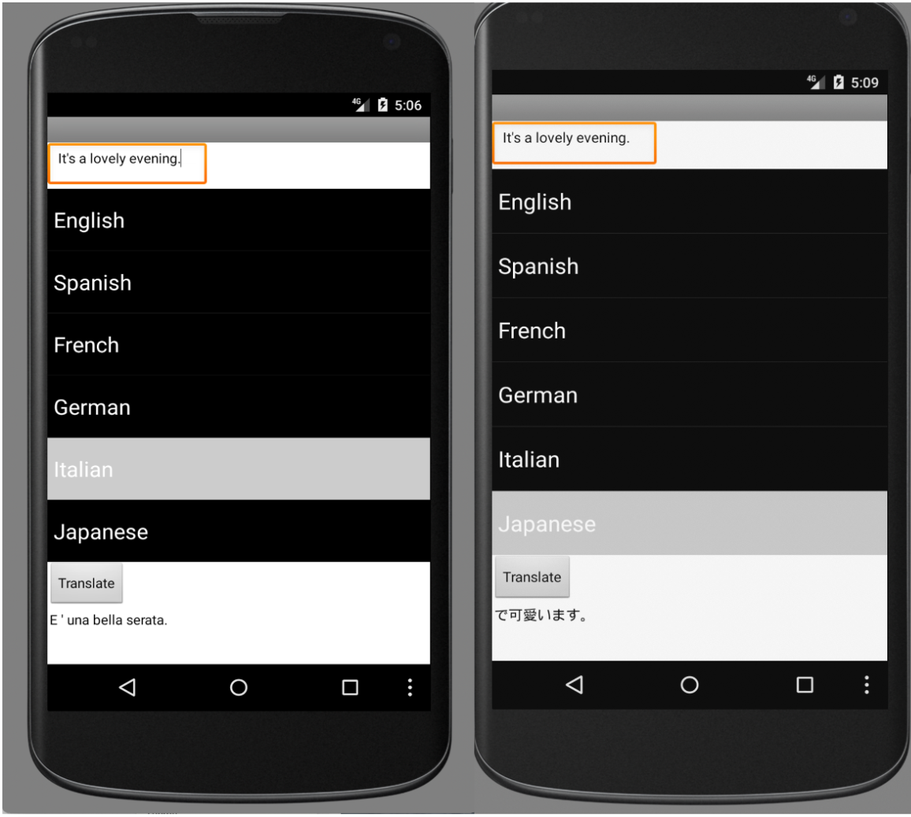
Making App creation easier via Block coding
Notes:
Instead of the traditional way of coding, we adopted a block coding style for kids to create their own mobile apps.
Here is an example of of a translator app showing it’s block code and it’s UI.
However, we our currently trying to push this further and create a platform where people can create a mobile app with just their natural language.

Slide 4
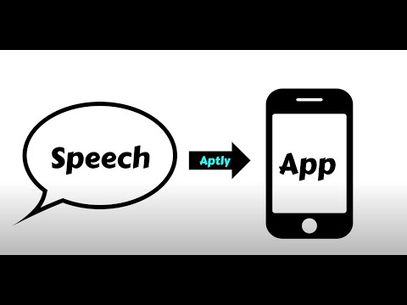
Aptly Demo
Notes:
Without further ado, let me show you a video demo of our new platform.

Slide 5
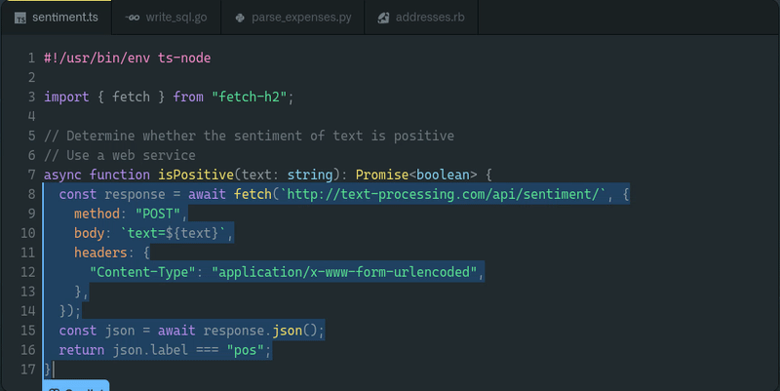
Code generative models
Notes:
When I first saw that demo it really blew my mind!
But this is not some magic, there is actually a lot of research and engineering involved to create such platform.
Some of you might have heard about github’s copilot and how it can automatically generate code. Copilot uses OpenAI’s Codex engine to do such task.
Aptly uses the same engine to generate mobile applications.

Slide 6
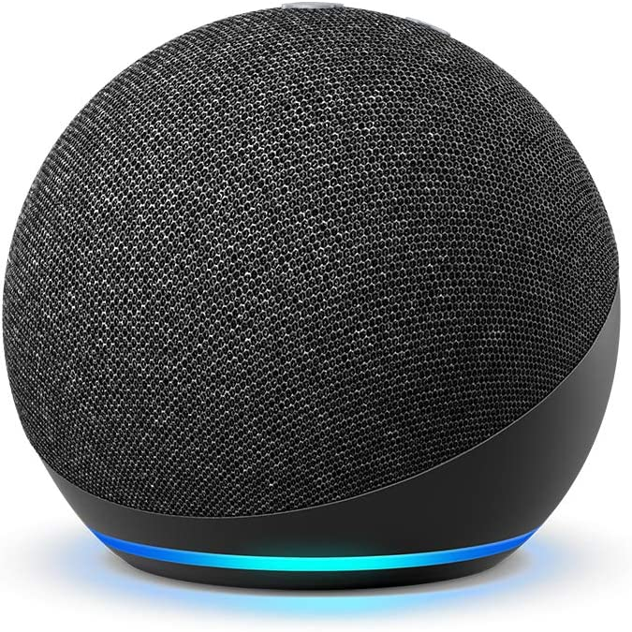
How Aptly Works
“Make an app with a text box, a list of six languages and a button that says ‘translate.’ …
“Make an app with a text box, a list of six languages and a button that says ‘translate.’ …
OR
Notes:
To overview the general scheme, a user can either type or speak their desired application

Slide 7
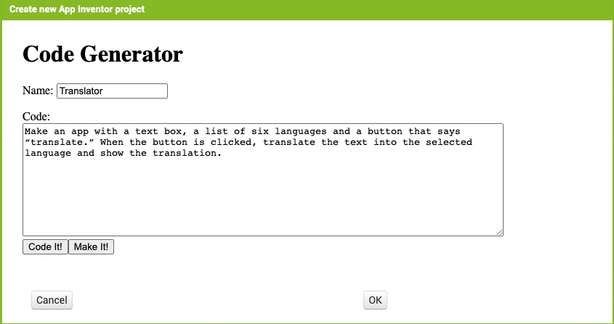
How Aptly Works
“Make an app with a text box, a list of six languages and a button that says ‘translate.’ …
“Make an app with a text box, a list of six languages and a button that says ‘translate.’ …
OR
Notes:
The description is feed into our platform.

Slide 8
How Aptly Works
“Make an app with a text box, a list of six languages and a button that says ‘translate.’ …
“Make an app with a text box, a list of six languages and a button that says ‘translate.’ …
OR
Notes:
Then we send that to OpenAI’s Codex model.

Slide 9
How Aptly Works
“Make an app with a text box, a list of six languages and a button that says ‘translate.’ …
“Make an app with a text box, a list of six languages and a button that says ‘translate.’ …
OR
Notes:
The codex engine will return a code that can convert to our App Inventor blocks

Slide 10
How Aptly Works
“Make an app with a text box, a list of six languages and a button that says ‘translate.’ …
“Make an app with a text box, a list of six languages and a button that says ‘translate.’ …
OR
Notes:
Which can be further converted into a fully functional mobile application.
While this is the general scheme

Slide 11
How Aptly Works
“Make an app with a text box, a list of six languages and a button that says ‘translate.’ …
“Make an app with a text box, a list of six languages and a button that says ‘translate.’ …
OR
Notes:
I want to describe this part a little bit deeper

Slide 12
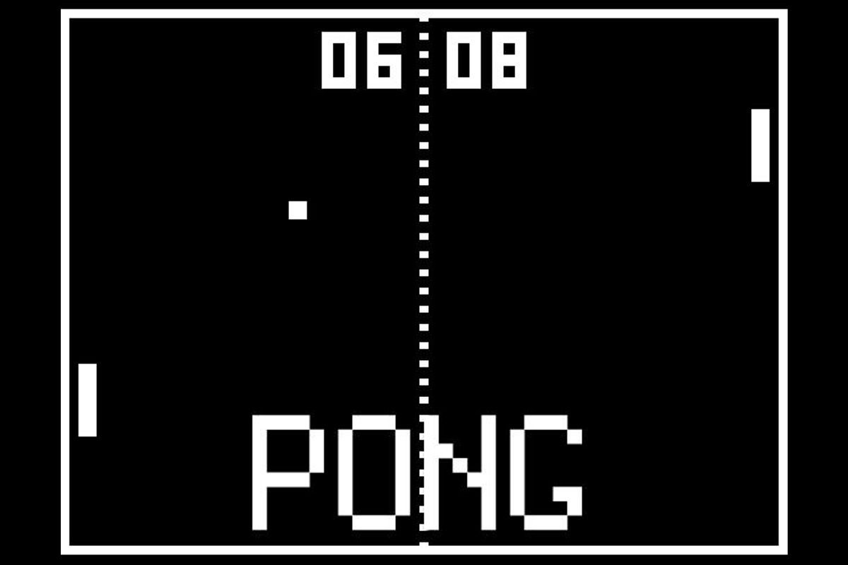
Prompt Engineering
Codex
“Make an app called Pong, where a ball bounce around…”
OpenAI, openai.com/blog, 2021
Notes:
Let’s say for instance that we want to create the game pong using Aptly. The user will describe the app with their natural language.

Slide 13
Prompt Engineering
Make the game Pong.
Notes:
However, if we simple input the user description into Codex. Codex will be very confused about what it needs to do with it.

Slide 14
Prompt Engineering
‘‘‘Create a ball.’’’
Ball = Ball(Screen1)
‘‘‘Create a paddle.’’’
Paddle = Rectangle(height = 2cm, width = 4cm)
…
‘‘‘Increment the score.’’’
int score = 0
if userWins():
score+=1
‘‘‘Make the game Pong.’’’
‘‘‘Create a ball.’’’
Ball = Ball(Screen1)
‘‘‘Create a paddle.’’’
Paddle = Rectangle(height = 2cm, width = 4cm)
…
‘‘‘Increment the score.’’’
int score = 0
if userWins():
score+=1
Few-Shot Examples
Codex learns from
Notes:
In order to solve that problem, we provide a few app inventor code examples along with the

Slide 15
Prompt Engineering
‘‘‘Create a ball.’’’
Ball = Ball(Screen1)
‘‘‘Create a paddle.’’’
Paddle = Rectangle(height = 2cm, width = 4cm)
…
‘‘‘Increment the score.’’’
int score = 0
if userWins():
score+=1
‘‘‘Make the game Pong.’’’
‘‘‘Create a ball.’’’
Ball = Ball(Screen1)
‘‘‘Create a paddle.’’’
Paddle = Rectangle(height = 2cm, width = 4cm)
…
‘‘‘Increment the score.’’’
int score = 0
if userWins():
score+=1
Few-Shot Examples
Codex learns from
App/Task Description
Codex completes
Notes:
User’s app description.

Slide 16
Prompt Engineering
‘‘‘Create a ball.’’’
Ball = Ball(Screen1)
‘‘‘Create a paddle.’’’
Paddle = Rectangle(height = 2cm, width = 4cm)
…
‘‘‘Increment the score.’’’
int score = 0
if userWins():
score+=1
‘‘‘Make the game Pong.’’’
‘‘‘Create a ball.’’’
Ball = Ball(Screen1)
‘‘‘Create a paddle.’’’
Paddle = Rectangle(height = 2cm, width = 4cm)
…
‘‘‘Increment the score.’’’
int score = 0
if userWins():
score+=1
Notes:
So each example consist of the description of their app

Slide 17
Prompt Engineering
‘‘‘Create a ball.’’’
Ball = Ball(Screen1)
‘‘‘Create a paddle.’’’
Paddle = Rectangle(height = 2cm, width = 4cm)
…
‘‘‘Increment the score.’’’
int score = 0
if userWins():
score+=1
‘‘‘Make the game Pong.’’’
‘‘‘Create a ball.’’’
Ball = Ball(Screen1)
‘‘‘Create a paddle.’’’
Paddle = Rectangle(height = 2cm, width = 4cm)
…
‘‘‘Increment the score.’’’
int score = 0
if userWins():
score+=1
Notes:
And the corresponding code implementation

Slide 18
Prompt Engineering
‘‘‘Create a ball.’’’
Ball = Ball(Screen1)
‘‘‘Create a paddle.’’’
Paddle = Rectangle(height = 2cm, width = 4cm)
…
‘‘‘Increment the score.’’’
int score = 0
if userWins():
score+=1
‘‘‘Make the game Pong.’’’
‘‘‘Create a ball.’’’
Ball = Ball(Screen1)
‘‘‘Create a paddle.’’’
Paddle = Rectangle(height = 2cm, width = 4cm)
…
‘‘‘Increment the score.’’’
int score = 0
if userWins():
score+=1
‘‘‘Make the game Pong.’’’
‘‘‘Create a ball.’’’
Ball = Ball(Screen1)
‘‘‘Create a paddle.’’’
Paddle = Rectangle(Screen1, height = 2cm, width = 4cm)
…
‘‘‘Increment the score.’’’
int score = 0
if userWins():
score+=1
Notes:
So now we have a completed input
In the computer science community, we commonly referred to these inputs as “prompts”

Slide 19
Prompt Engineering
‘‘‘Create a ball.’’’
Ball = Ball(Screen1)
‘‘‘Create a paddle.’’’
Paddle = Rectangle(height = 2cm, width = 4cm)
…
‘‘‘Increment the score.’’’
int score = 0
if userWins():
score+=1
‘‘‘Make the game Pong.’’’
‘‘‘Create a ball.’’’
Ball = Ball(Screen1)
‘‘‘Create a paddle.’’’
Paddle = Rectangle(height = 2cm, width = 4cm)
…
‘‘‘Increment the score.’’’
int score = 0
if userWins():
score+=1
‘‘‘Make the game Pong.’’’
‘‘‘Create a ball.’’’
Ball = Ball(Screen1)
‘‘‘Create a paddle.’’’
Paddle = Rectangle(Screen1, height = 2cm, width = 4cm)
…
‘‘‘Increment the score.’’’
int score = 0
if userWins():
score+=1
Codex
OpenAI, openai.com/blog, 2021
Notes:
We feed this prompt into Codex

Slide 20
Prompt Engineering
‘‘‘Create a ball.’’’
Ball = Ball(Screen1)
‘‘‘Create a paddle.’’’
Paddle = Rectangle(height = 2cm, width = 4cm)
…
‘‘‘Increment the score.’’’
int score = 0
if userWins():
score+=1
‘‘‘Make the game Pong.’’’
‘‘‘Create a ball.’’’
Ball = Ball(Screen1)
‘‘‘Create a paddle.’’’
Paddle = Rectangle(height = 2cm, width = 4cm)
…
‘‘‘Increment the score.’’’
int score = 0
if userWins():
score+=1
‘‘‘Make the game Pong.’’’
‘‘‘Create a ball.’’’
Ball = Ball(Screen1)
‘‘‘Create a paddle.’’’
Paddle = Rectangle(Screen1, height = 2cm, width = 4cm)
…
‘‘‘Increment the score.’’’
int score = 0
if userWins():
score+=1
Codex
OpenAI, openai.com/blog, 2021
Ball = Ball(Screen1)
Paddle = Rectangle(height = 2cm, width = 4cm)...
Notes:
Which outputs the desired code, hopefully… that code will convert into a fully functional application using the app inventor platform.

Slide 21
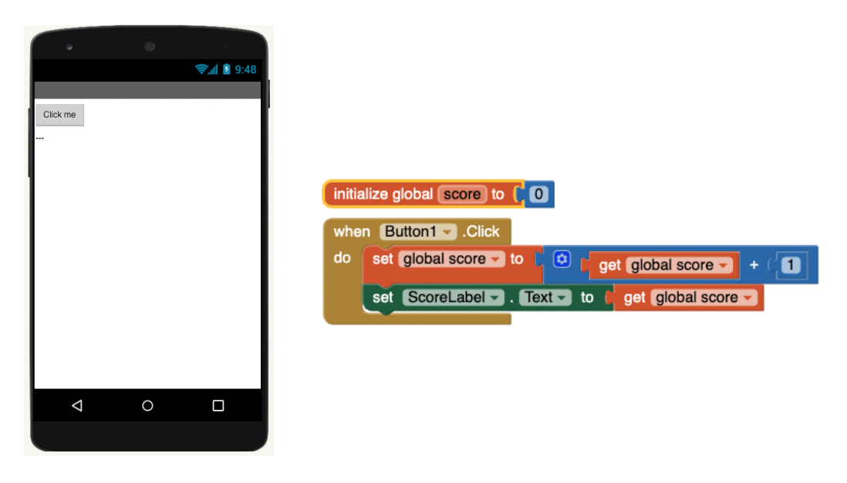
Working example (1)
Make a game that has a button in the middle of the screen. When a user clicks the button, increment the score by 1
Notes:
Here I want to show some examples, the first one is this simple app where there is button in the screen, and adds 1 whenever the user clicks the button.
You can see that the functionality is well created by observing the blocks are well defined, but the button is not in the middle.

Slide 22
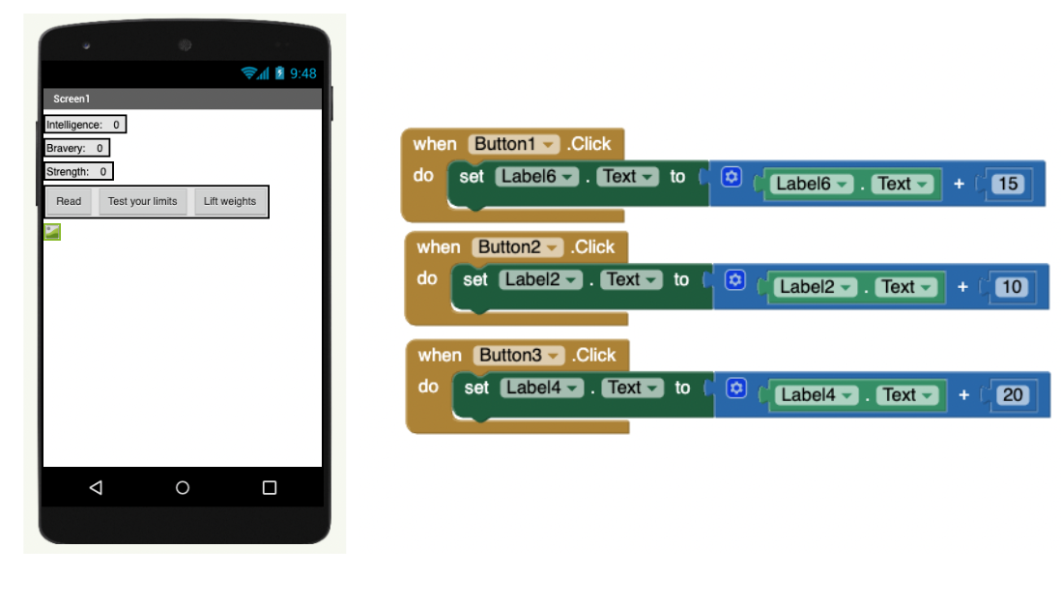
Working example (2)
Create a character that has attributes: intelligence, bravery, and strength. If the reader clicks the 'read' button, increment intelligence by 10. If the reader clicks the 'Test your limits' button, increase bravery by 20. If the reader clicks the 'lift weights' button, increase strength by 15.
Notes:
Here is a slightly more advanced version, where there are three buttons, and each buttons increases independently with different amount.
Here also the functionality is well created

Slide 23
Working example (2)
Create a character that has attributes: intelligence, bravery, and strength. If the reader clicks the 'read' button, increment intelligence by 10. If the reader clicks the 'Test your limits' button, increase bravery by 20. If the reader clicks the 'lift weights' button, increase strength by 15.
Notes:
but there is a problem with the image.

Slide 24
Working example (2)
Create a character that has attributes: intelligence, bravery, and strength. If the reader clicks the 'read' button, increment intelligence by 10. If the reader clicks the 'Test your limits' button, increase bravery by 20. If the reader clicks the 'lift weights' button, increase strength by 15.
Notes:
Ideally, It should have created a character image. However, Aptly does not have that capability yet and we are currently working on ways to make such capabilities.

Slide 25
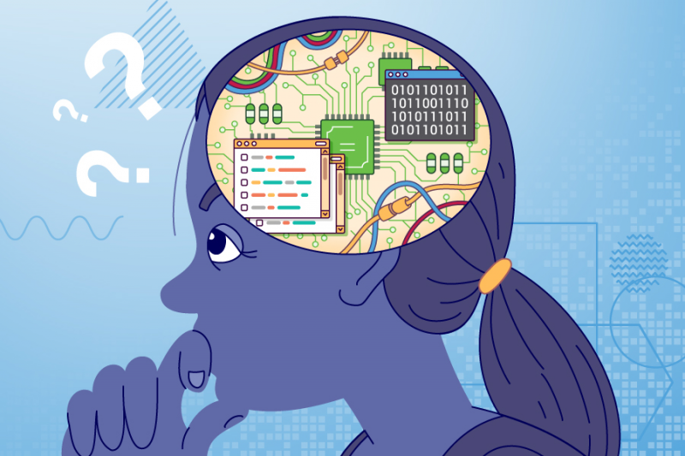
Implication on Computational Thinking Education
Notes:
I want to shift gears and talk about Aptly’s educational implications. There are two main streams of opinion when it comes to computational thinking. Some consider that the act of coding is essential in computational thinking, while others consider to be marginal. Aptly aligns with the second view being related to the “no-code” movement.
We believe that coding actually hinders kids to participate in technology and hope that Aptly will facilitate kids interest in programming and further encourage them to participate in STEM society.

Slide 26
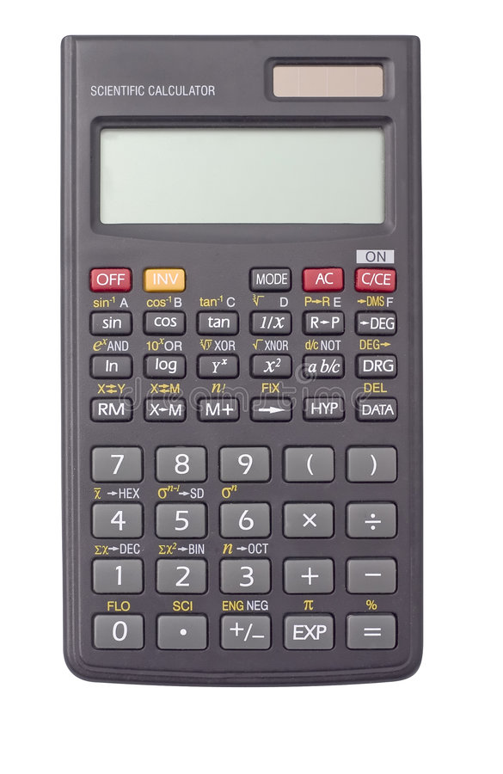
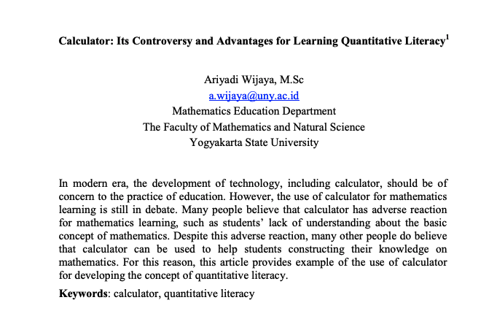
Will Aptly be a crutch or a springboard?
Notes:
However, we are also aware of the other side of the coin, that such platform might deteriorate people’s computational abilities.
It is similar to when calculators first came out, there were lots of controversies whether calculators would harm people’s mathematical learning while some people believed that it will help them.
What is your opinion? Will Aptly be a crutch or a springboard? Please share your thoughts!

Slide 27
Further Research
Can we help kids handle the syntactic challenge describing their desired app?
“Make an app with a textbox, a list of six languages and a button that says “translate”. When~
Challenge for kids, can we make it easier?
Would an AI augmented app inventor platform help students create mobile applications?
Can kids and AI cooperate?
Notes:
So here are the research questions we are tackling regarding computational thinking.
First is, ~~~, so the issue is, when you describe your mobile application you actually have to be very meticulous about how you describe it.
For the translator app, you have to say “
This is a challenge for kids and we are developing ways to help students formulate and describe what they really want to make.
Second is, ~~~, we want to know if kids collaborate with these new AI technologies, will they able to create more interesting applications and increase their interest in technology.
While these are the main research questions we plan to answer, that does not mean we are limited to such. We plan to do many research regarding Aptly and it’s educational issues.

Slide 28
Follow our work
Main Page: https://appinventor.mit.edu/
Research page: https://appinventor.mit.edu/explore/research
Blog Post: https://appinventor.mit.edu/blogs/hal/2022/03/21/Aptly
Twitter: https://twitter.com/MITAppInventor
Linkedin: https://www.linkedin.com/company/mit-app-inventor/
Notes:
Please follow our work in these websites, if you are interested let me know I’ll send you individually how to reach us

Slide 29
Questions

